Slide 1
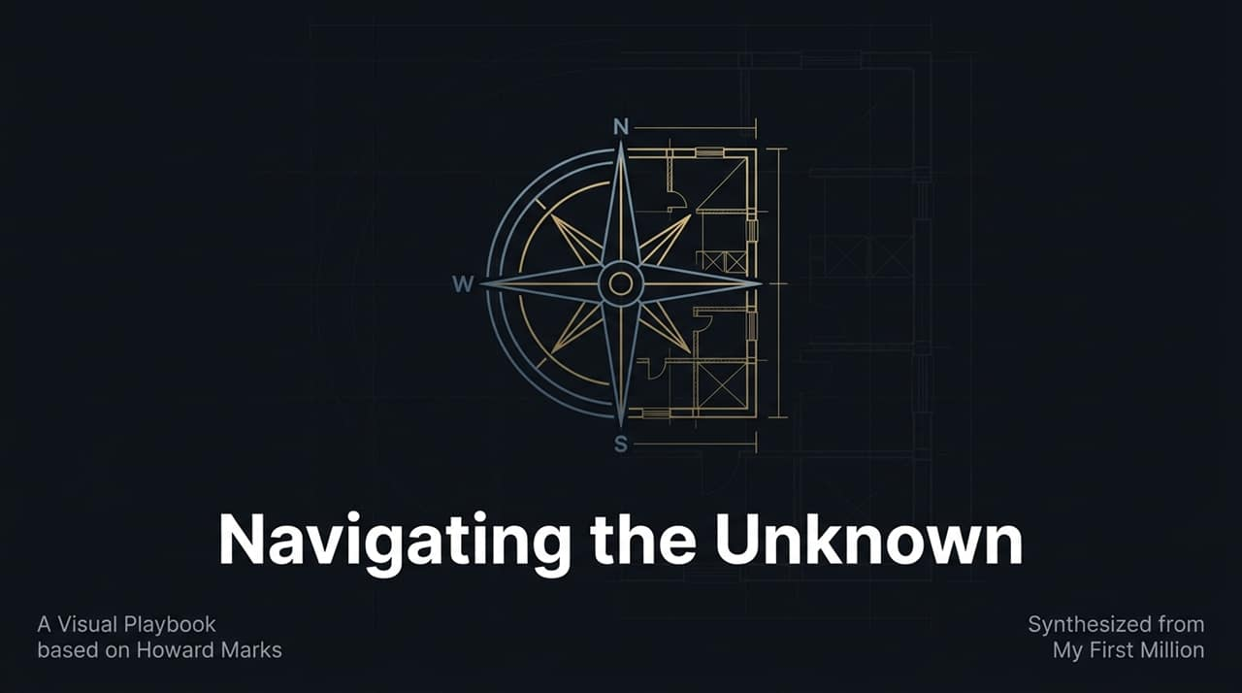
Notes:
Source: https://www.youtube.com/watch?v=Kp__G0eUyIc
Introduction: "Welcome everyone. Today we are exploring 'The Uncertainty Blueprint'—a framework synthesized from legendary investor Howard Marks' conversation on My First Million."
Context & Hook: "In an era increasingly dominated by technology, artificial intelligence, and macro volatility, we often ask: What can computers do, and what is left for humans? Marks argues that while AI can process vast amounts of historical data instantly, true outperformance and survival come from human judgment, emotional discipline, and second-level thinking—the things AI cannot calculate."
Session Purpose: "Over the next 16 slides, we will break down four critical pillars: how AI changes technology, how to deploy capital in extreme markets, how to build 30+ year partnerships, and how to design an intentional life."

Slide 2
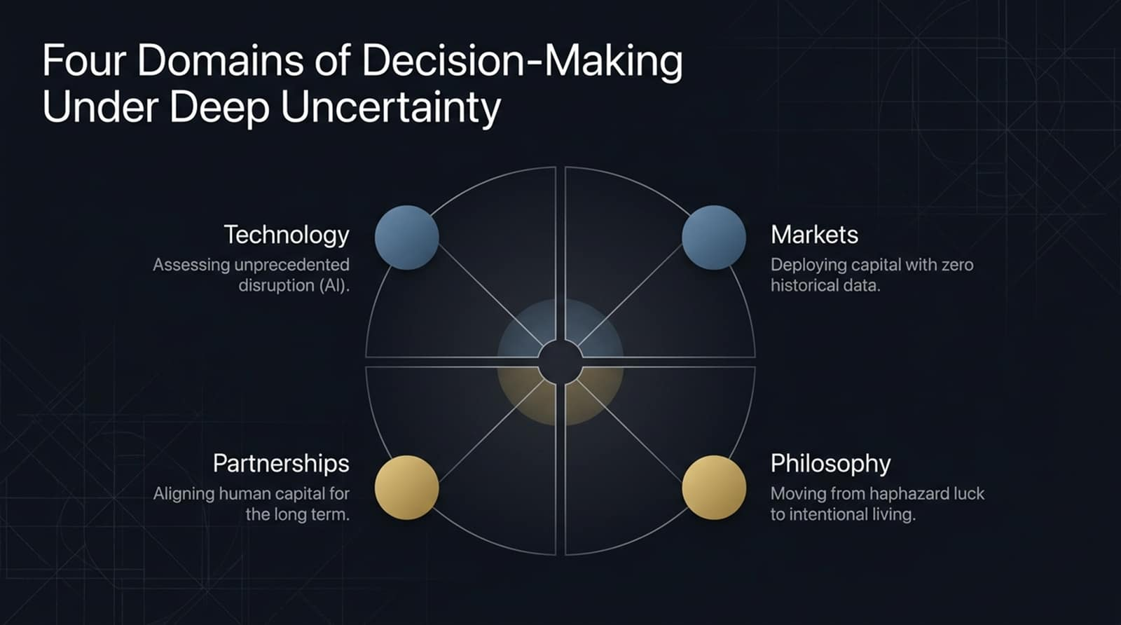
Notes:
Overview: "To navigate deep uncertainty, we must evaluate decisions across four interconnected domains:
Technology: Assessing unprecedented technological disruptions like AI, where historical models fail.
Markets: Deploying capital during moments of crisis when you have zero historical precedent.
Partnerships: Aligning human capital, shared ethics, and complementary talents for decades.
Philosophy: Shifting from living life on autopilot to making intentional choices."
Key Takeaway: "Mastery isn't just about picking stocks or analyzing balance sheets; it requires a holistic blueprint that balances intellect, emotional fortitude, and self-awareness."

Slide 3
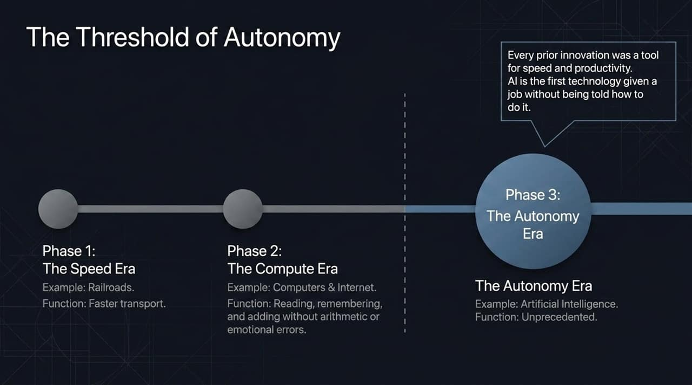
Notes:
Historical Context: "In Howard Marks' recent memos, he highlights why AI is fundamentally different from every innovation that came before it."
The Three Eras:
Phase 1 (Speed Era): "Inventions like railroads simply accelerated physical movement."
Phase 2 (Compute Era): "Traditional computers and the internet allowed us to read, remember, add, and subtract without arithmetic error or emotional fatigue."
Phase 3 (Autonomy Era): "AI breaks this boundary. Marks notes that AI is the first technology given a job without being told step-by-step how to do it."
Video Reference: "As Marks explained on the podcast: 'All other technological innovations... were all tools to speed up and increase productivity. There's never been anything with the quality of autonomy—the idea that you can give it a job and not tell it how to do it, and it'll figure it out'."

Slide 4
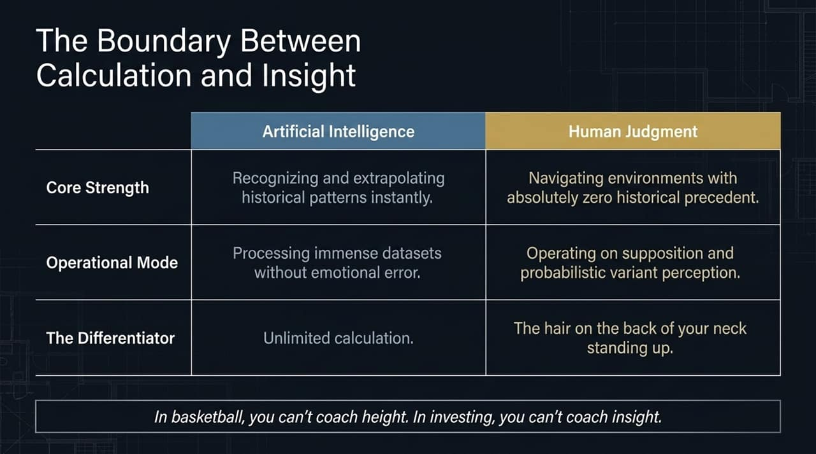
Notes:
Comparison Matrix:
Data Processing: AI excels at recognizing and extrapolating historical patterns. Humans excel when operating in environments with zero historical precedent.
Operational Mode: AI processes massive datasets without bias, while human judgment relies on probabilistic variant perception.
The Human Advantage: "What is left that AI cannot do? Marks points to instinct and qualitative judgment. For instance, avoiding bad actors: 'Sometimes you talk to people and for undefinable reasons... the hair on the back of your neck goes up. If AI doesn't have hair on its neck, maybe there's a role left for experienced investors with judgment'."
Closing Quote: "As Marks quips regarding outperformance: 'In basketball, you can't coach height. In investing, you can't coach insight'."

Slide 5
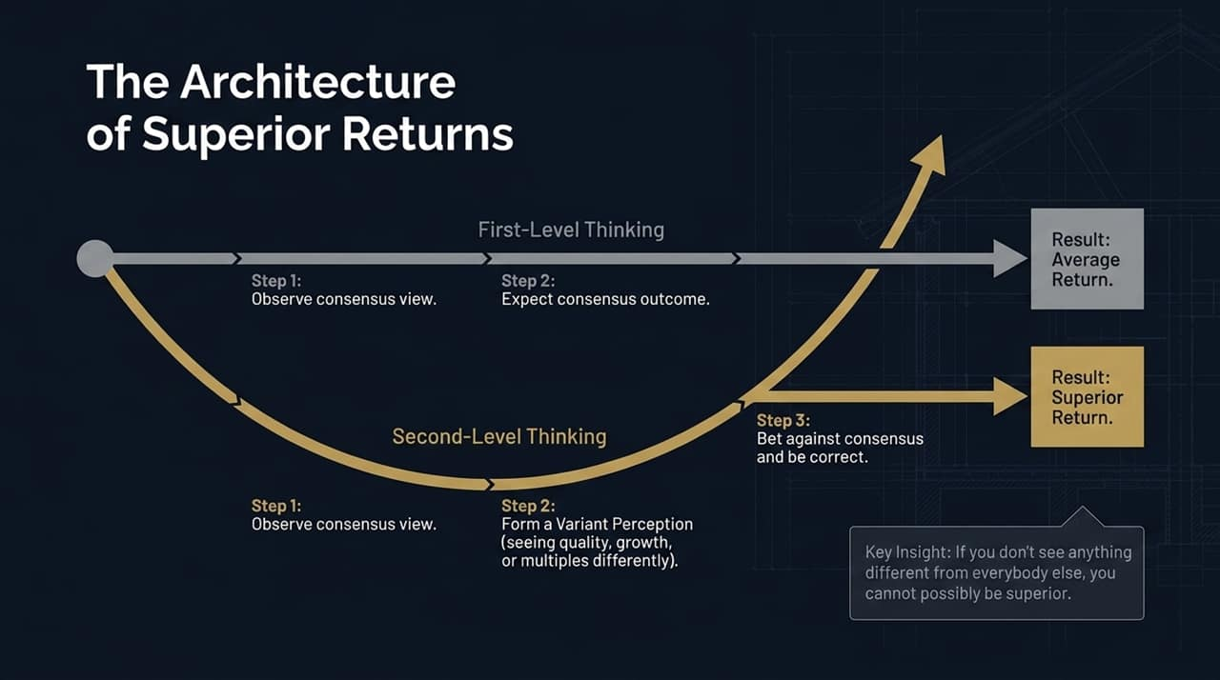
Notes:
First-Level Thinking: "First-level thinkers see the world simply: 'It's a good company, so let's buy the stock'. They follow consensus and naturally get average returns."
Second-Level Thinking: "To achieve superior returns, you must engage in second-level thinking. You observe the consensus view, form a Variant Perception (evaluating growth, quality, or multiples differently), bet against consensus, and be right."
Video Reference: "Marks emphasizes: 'If you don't see anything different from everybody else, you cannot possibly be superior'. Can second-level thinking be taught? Marks admits he can teach you the importance of it, but not how to have unique insights that differ from consensus and turn out to be correct."

Slide 6
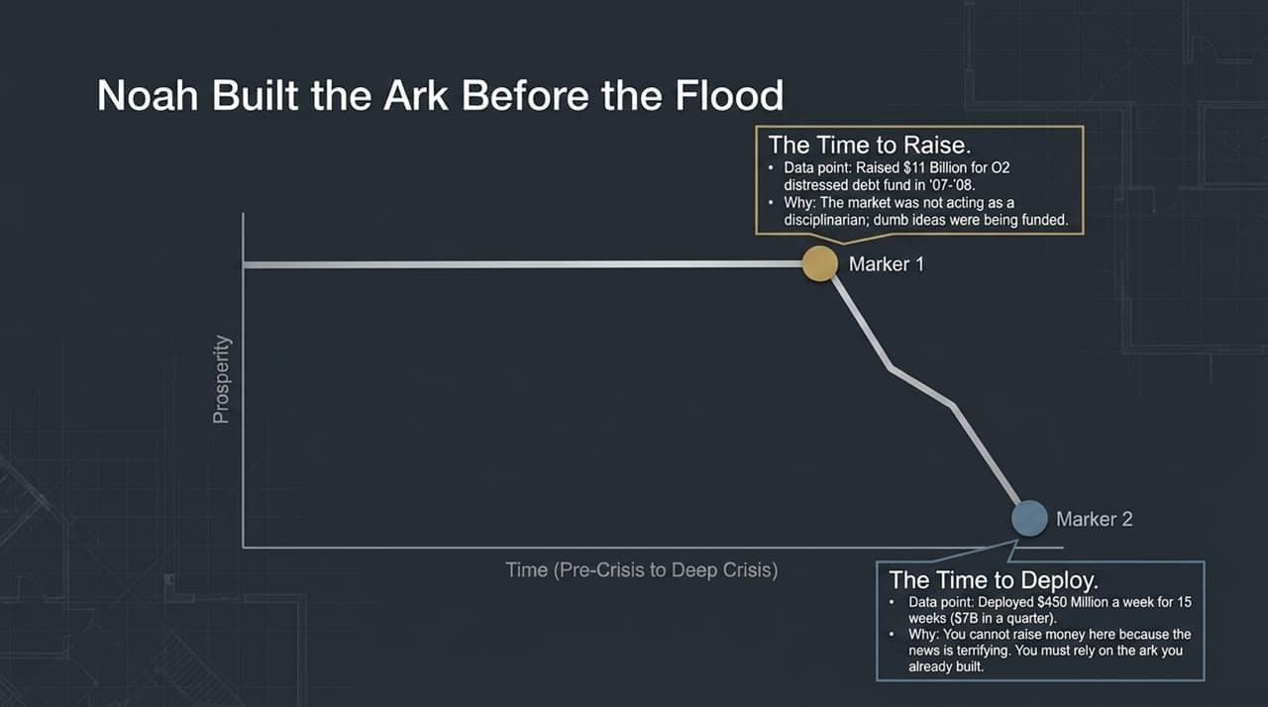
Notes:
The Analogy: "Citing a favorite movie line, Marks asks: 'When did Noah build the ark? Before the flood'. You cannot build protection or raise capital in the middle of a deluge."
Marker 1 (The Raising Phase - 2007/2008): "In 2007–2008, Oaktree raised an unprecedented $11 billion distressed debt fund. Why? Because the market was failing its main job as a disciplinarian—dumb ideas were getting funded."
Marker 2 (The Deployment Phase): "When Lehman Brothers collapsed in late 2008, Oaktree deployed $450 million a week for 15 weeks ($7 billion in one quarter). They could do this only because they built the capital 'ark' before the panic hit."

Slide 7
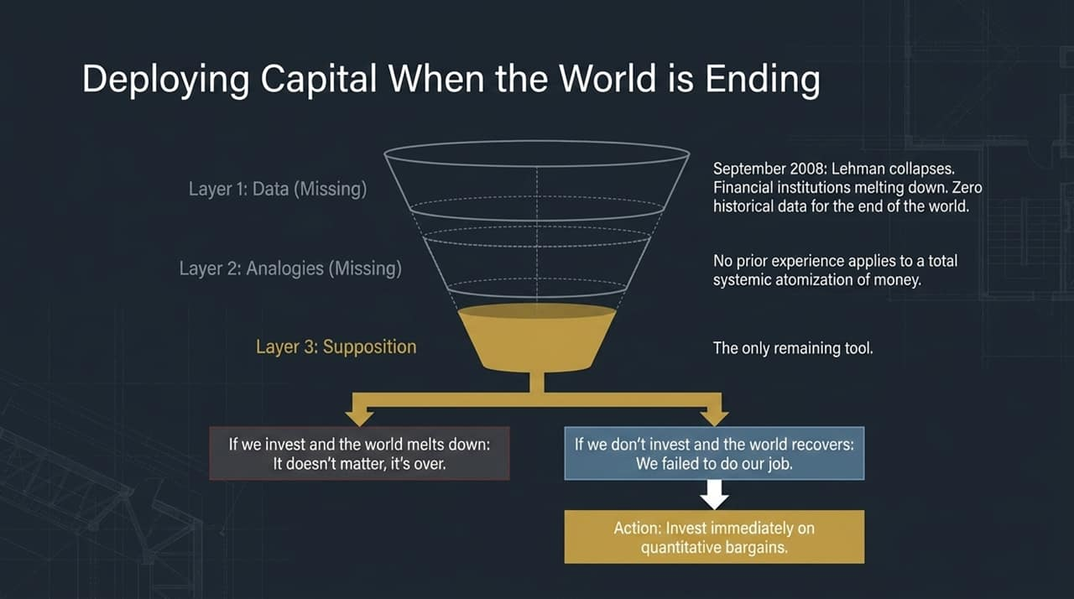
Notes:
The 3-Layer Framework: "During crisis, decision-making relies on three layers: Data, Analogies, and Supposition."
Layer 1 (Data): Missing. There is no historical dataset for the total meltdown of the global financial system.
Layer 2 (Analogies): Missing. No past experience applies to systemic failure.
Layer 3 (Supposition): The only remaining tool.
The Decision Matrix: "In September 2008, Marks and his partner Bruce Karsh faced a stark binary choice:
If we invest and the world melts down: It doesn't matter, because money will cease to hold value anyway.
If we don't invest and the world recovers: We failed to do our job."
Action: "They acted decisively on quantitative bargains, buying senior debt at massive discounts."

Slide 8
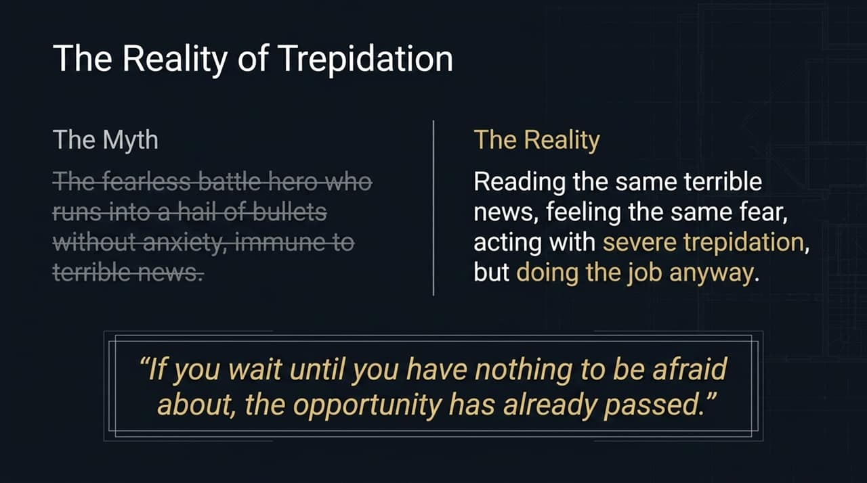
Notes:
The Myth vs. Reality: "We often imagine great investors as fearless battle heroes who charge into falling markets without anxiety. Marks dismantles this myth."
Video Reference: "Marks shares: 'I read the same newspapers, watch the same TV, and see the same terrible news. I overcome it in some way, but I'm not immune. A battle hero is not somebody who's unafraid; it's somebody who's afraid but does it anyway'."
Key Takeaway: "'If you wait until you have nothing to be afraid about, the opportunity has already passed'."

Slide 9
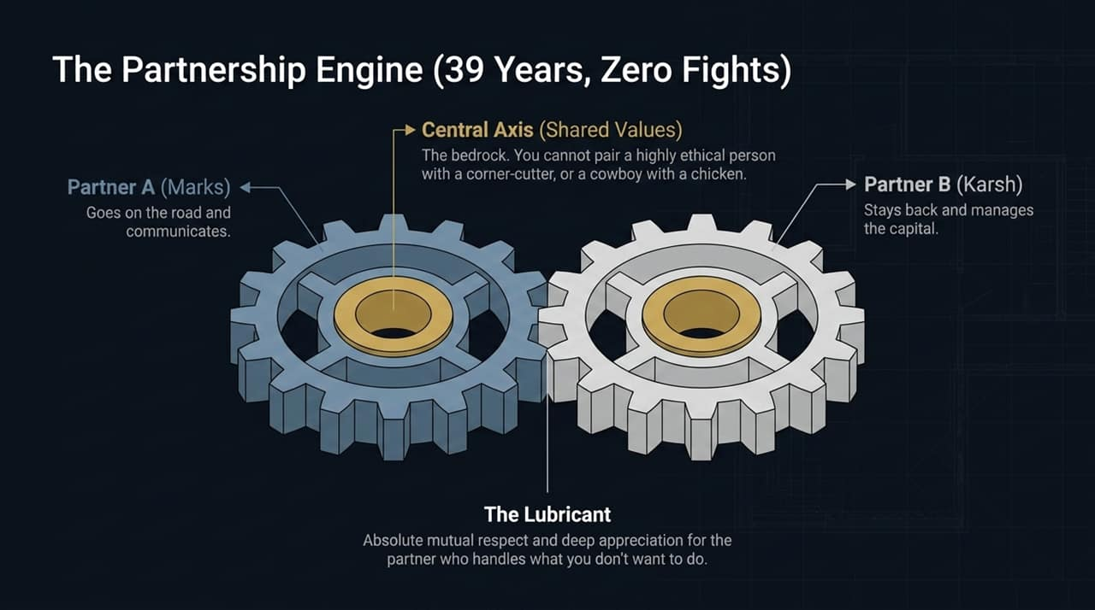
Notes:
The Model: "Howard Marks and Bruce Karsh have been partners at Oaktree for 39 years without ever having a major fight."
The Two Pillars:
Central Axis (Shared Values): "You cannot pair a highly ethical person with a corner-cutter, or a 'cowboy' with a 'chicken'. In bad times, chickens say cowboys are killing them; in good times, cowboys say chickens hold them back."
Complementary Skills: "Marks goes on the road, communicates, and writes memos; Karsh stays back and manages the portfolio. Both respect and appreciate what the other brings to the table."

Slide 10
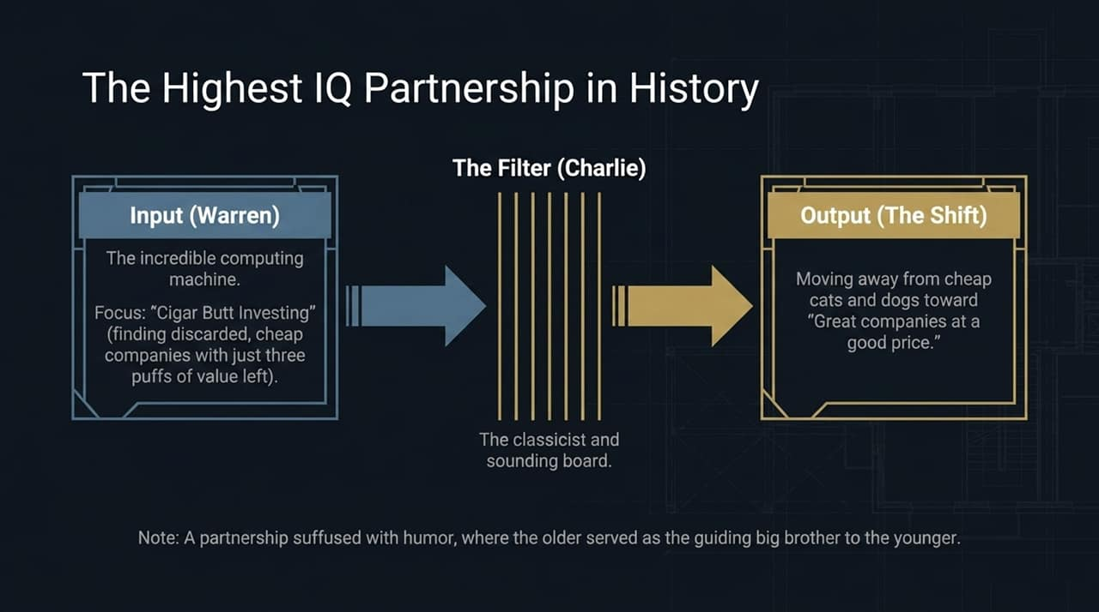
Notes:
The Input (Warren Buffett): "Buffett began his career practicing Benjamin Graham's 'cigar butt investing'—finding discarded, cheap companies with just three 'puffs' of value left."
The Filter (Charlie Munger): "Munger acted as the classicist, humanist, and logical sounding board."
The Paradigm Shift: "Munger convinced Buffett to move away from cheap 'cats and dogs' toward buying great companies at a good price."
Relationship Dynamic: "Their 60+ year partnership was suffused with humor, mutual respect, and affection—proof that human connection drives long-term compounding."

Slide 11
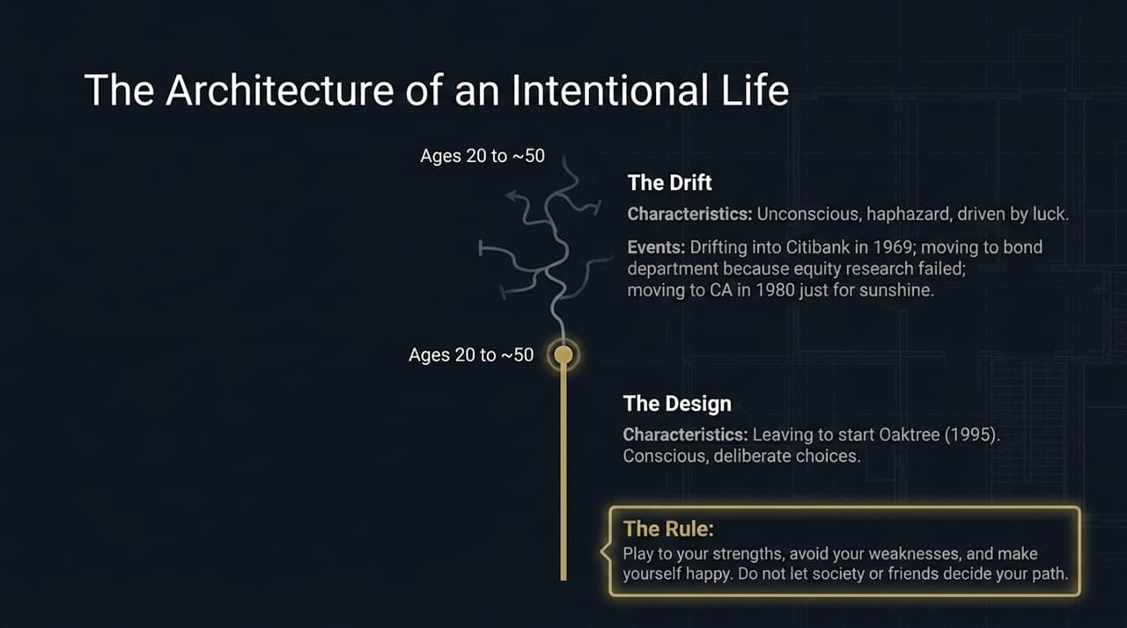
Notes:
The Drift (Ages 20 to ~50): "Marks candidly admits that for the first half of his career, he 'drifted'. He joined Citibank by chance in 1969, moved to bonds because equity research didn't work out, and moved to California just for sunshine."
The Design (Ages 50+): "In 1995, at age 49, Marks intentionally chose to start Oaktree."
The Golden Rule: "Quoting Christopher Morley, Marks notes: 'There is only one success: to live your life your own way'. Play to your strengths, avoid your weaknesses, and do not let society, peers, or parents dictate your career choices."

Slide 12
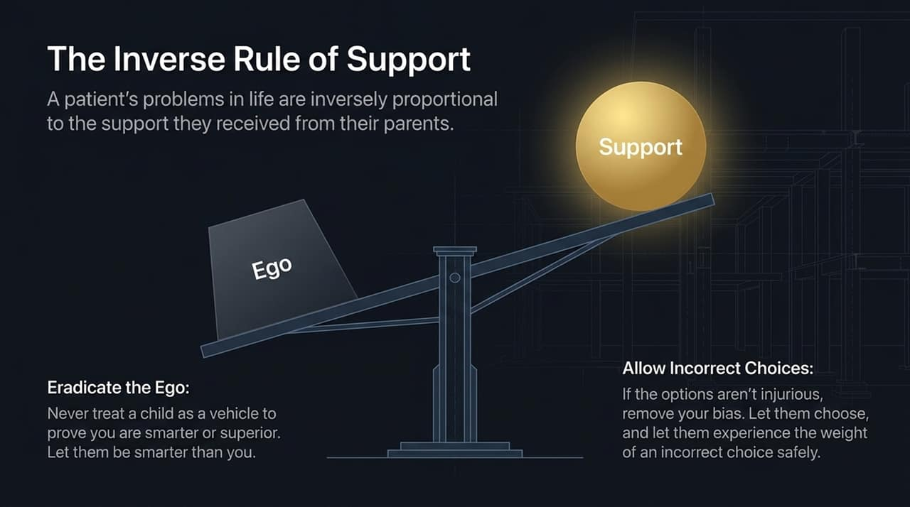
Notes:
The Wall Street Shrink Insight: "Marks cites a Wall Street psychiatrist who observed that patients' emotional problems were inversely proportional to the support they received from their parents."
Eradicate Ego: "Successful people often feel a need to assert superiority over their children. Marks advises: 'Let them be smarter than you in certain areas'."
Allowing Safe Failures: "Unless a choice is physically or emotionally injurious, step back and let children or team members make their own decisions—even if they make incorrect ones—so they learn the weight of choice."

Slide 13
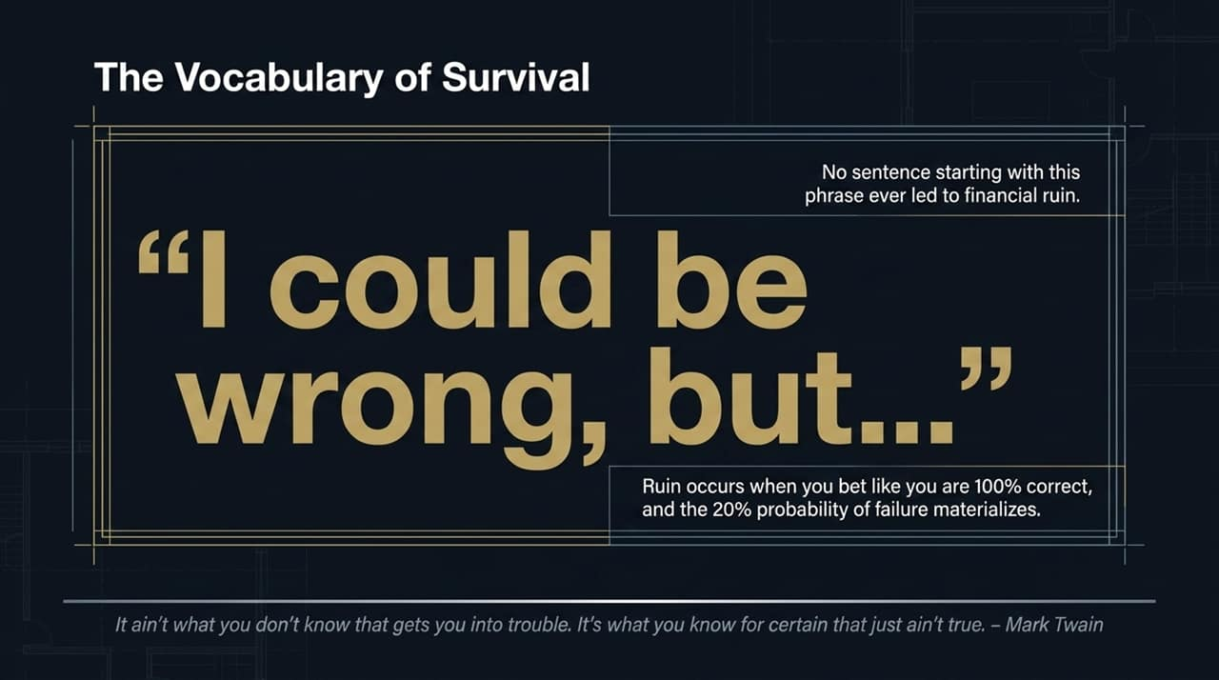
Notes:
The Magic Phrase: "Marks states that no sentence starting with 'I could be wrong, but...' ever led to financial ruin."
How Ruin Happens: "Ruin occurs when you bet as if you are 100% certain, but the unhedged 20% probability of failure materializes."
Mark Twain Quote: "'It ain't what you don't know that gets you into trouble. It's what you know for certain that just ain't true'."

Slide 14
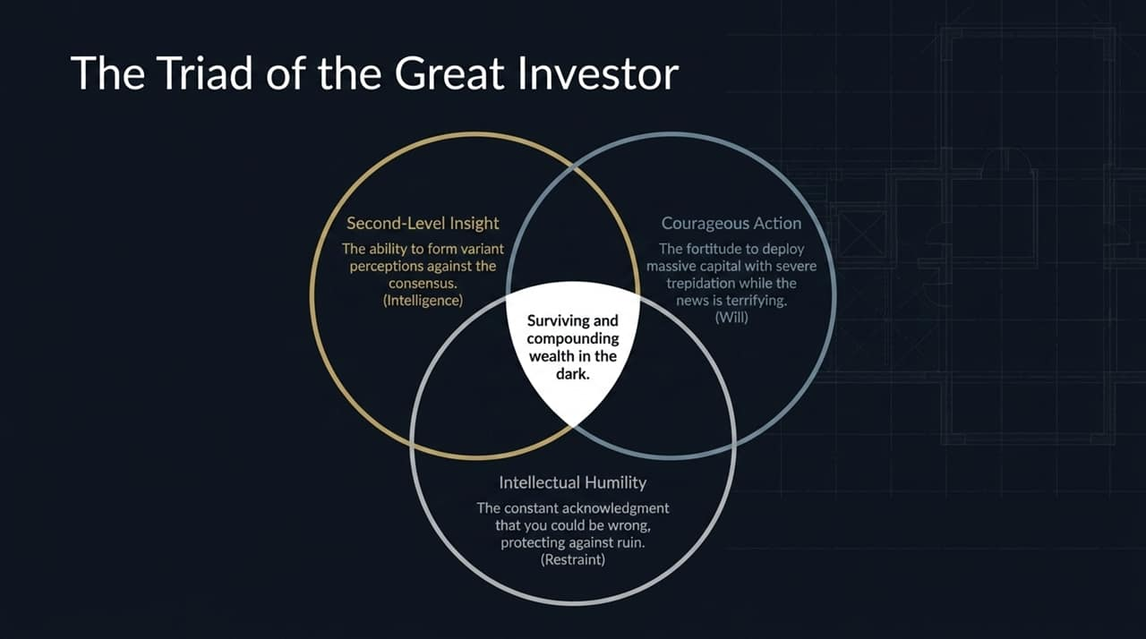
Notes:
The Three Elements:
Second-Level Insight (Intelligence): The cognitive capacity to form correct variant perceptions against consensus.
Courageous Action (Will): The fortitude to deploy massive capital with trepidation when the news is terrifying.
Intellectual Humility (Restraint): The constant acknowledgment of uncertainty that prevents catastrophic risk.
Summary: "Take away any one of these legs, and the stool collapses."

Slide 15
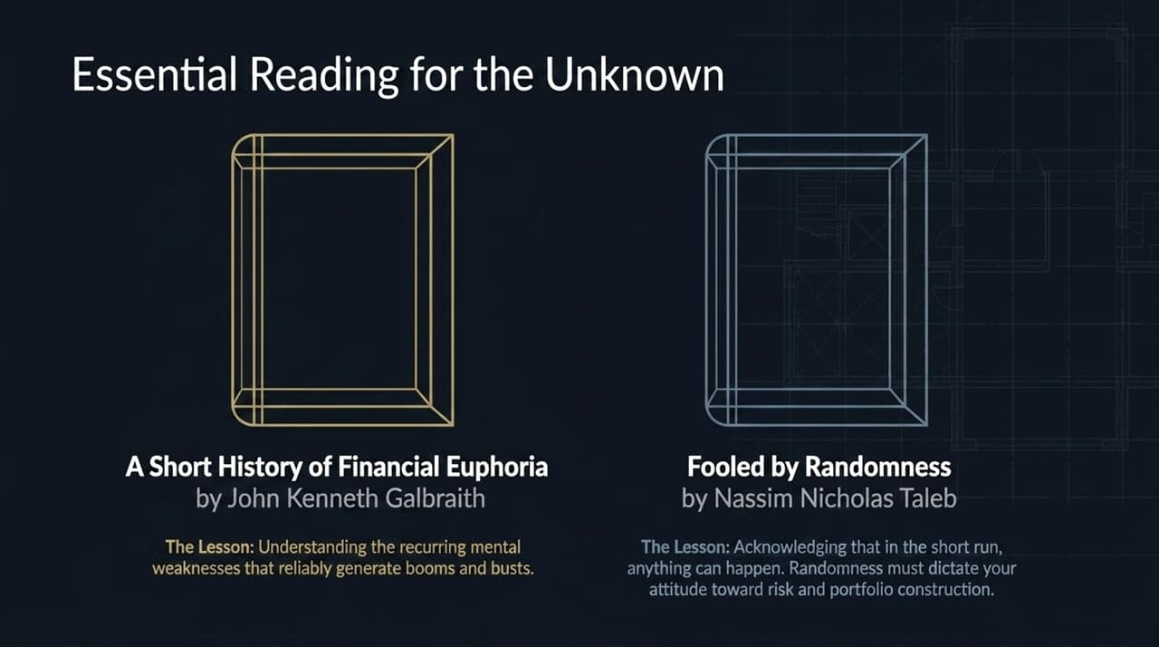
Notes:
Book 1: A Short History of Financial Euphoria by John Kenneth Galbraith:
Core Lesson: Teaches the recurring human psychological weaknesses that reliably generate speculative booms and busts.
Book 2: Fooled by Randomness by Nassim Nicholas Taleb:
Core Lesson: Reminds us that in the short run, luck and randomness dictate outcomes. This realization must shape our attitude toward risk management and portfolio design.

Slide 16
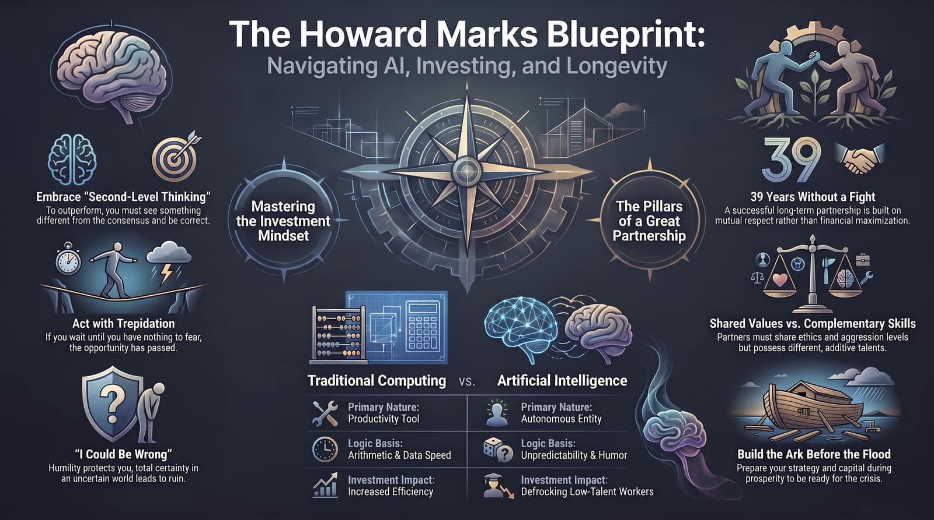
Notes:
Conclusion: "To summarize our blueprint for navigating the unknown:
Technology: AI provides speed and autonomy, but humans provide insight and qualitative judgment.
Investing: Practice second-level thinking, build your ark before the flood, and act despite trepidation.
Partnerships: Ground long-term relationships in shared values and mutual respect.
Life: Stay humble with 'I could be wrong', and live life by design, not by drift."
Q&A Opening: "Thank you. I'd now like to open the floor to questions."

